Slide 1


DFV-Chogori Project A memory centric distributed transactional platform
SIGMOD 2020 Talk
Seattle Cloud Lab/Cloud Storage Team
06/18/2020

Slide 2
Agenda
Chogori Project Overview
Given by Hao “Jerry” Feng (jerry.feng@futurewei.com)
Chogori low latency platform - integrated computing, networking scheduling, etc.
Given by Justin Funston (justin.funston@futurwei.com)
Novel low latency distributed transaction protocol K2-3SI and TSO in Chogori
Given by Ivan Avramov (ivan.avramov@futurewei.com)

Slide 3
Chogori Project Overview
Chogori is piloting project for next generation of cloud scale distributed data platform.
High efficient distributed transaction with strong consistency and high throughput.
Microsecond latency distributed operation with memory centric processing.
Flexible platform architecture for future multiple cloud scale services
Newly cloud DC technology is driving new efficient and cost effective system architecture.
Computing – Moore’s law, Amdahl's law -> coordination-free parallelism. SIMD, GPU, and DSA.
Networking – Faster, kernel bypass.
Storage - New memory/storage tier.
Chogori innovations (phase I)
Low latency platform – integrated network core bypass and data processing
K2-3SI – Sequential consistency with external causal relationship, and Serializable Snapshot Isolation level.

Slide 4
Chogori Platform – Goals
Microsecond-level request latencies
High throughput: >100,000 requests/second/core
Multi-core scalability
Utilize cutting edge network and storage technology
Kernel bypass and poll-mode I/O

Slide 5
Chogori Platform – Design Principles
Per-core shared nothing by default (from Seastar)
No locks, minimal cross-core synchronization
Each core operates on its own partition of the data
Asynchronous user-level task scheduling (from Seastar)
OS thread scheduling is expensive
Future, promise, and continuation pattern
Kernel-bypass networking (Chogori)
Context switch is expensive
Poll-mode for low latency
We use RDMA

Slide 6
Network & Transport
Per-core addressability (shared nothing)
Each core polls its own RX queue and sends on its own TX queue
No cross-core dispatch
Options: DPDK w/ SR-IOV, DPDK w/ flow director, RDMA queue pairs (QPs)
App 1
App 2
Socket Dispatch
CPU 1
CPU 2
CPU 3
CPU 4
CPU 5
CPU 6
CPU 1
CPU 2
CPU 3
CPU 4
CPU 5
CPU 6
NIC QP Dispatch
NIC RSS Hash
Incoming packets
Incoming packets

Slide 7
Network & Transport
Familiar socket-like interface
Send, receive
Listen, accept, connect
Flow control, congestion control, retransmission
TCP is complicated and user-space TCP libraries are not mature
UDP-based protocols are a possibility (eRPC, HOMA, etc.)
Our choice: Reliable connected (RC) RDMA
RDMA RC Send and Receive Operations
Layer above is message-oriented and network agnostic. Can use RDMA for performance or kernel TCP for compatibility.

Slide 8
Chogori RPC
Future-based RPC request and reply
Automatic serialization and deserialization
Minimized copies

Slide 9
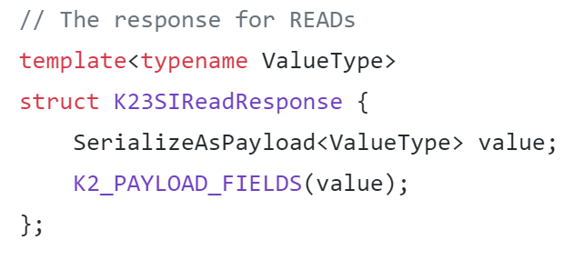
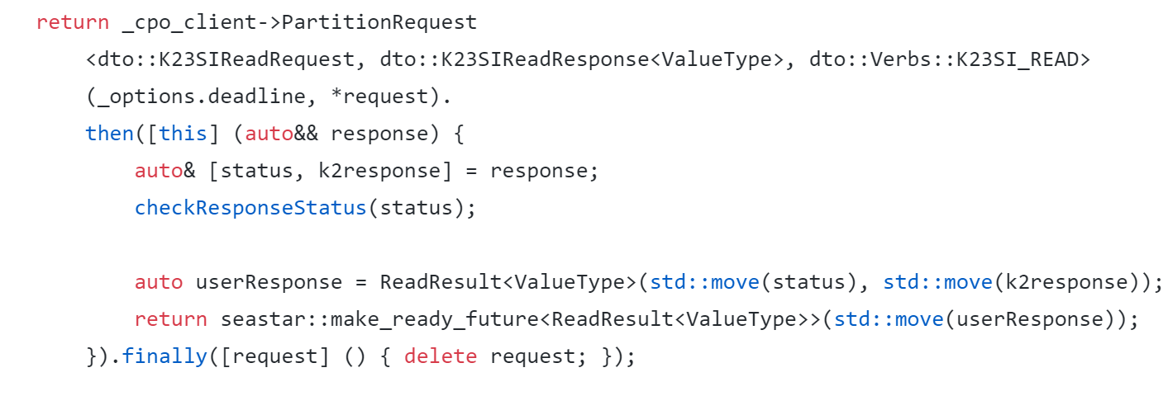
Chogori RPC

Slide 10
Chogori RPC – “Payload”
Segmented smart buffers for network transport
Minimizes copies
0-copy send and receive if payload native
1 copy (serialization/deserialization) otherwise
User data serialized
2nd block user data serialized
3rd block user data serialized
RPC header written
4
1
2
3
MTU
User Data

Slide 11
Distributed Transaction Tradeoffs
Consistency
PRAM → Causal → Sequential → Linearizable
Isolation
Read Committed → Snapshot Isolation → Serializable
Performance
Consequence of providing specific levels of consistency and isolation.
Typically dominated by the need for round-trip network communication, especially if it is a remote DC call.
Some require additional artificial wait (x…xxx ms) to achieve correctness
Name | Local DC roundtrip | Remote DC roundtrip
Percolator | ~0-10? | 8-14?
TiDB | 0 | 14
Spanner | 1 | 8
YugabyteDB | 4 | 10
CockroachDB | 4 | 6
Webinar: Comparing Distributed Transaction Architectures for the Cloud Era
https://www.youtube.com/watch?v=w_zYYF3-iSo

Slide 12
Transaction Design Goals
Support for global transactions over datasets spanning availability zones
Scalable, multi-reader, multi-writer architecture
In-memory oriented data storage
Take advantage of low-latency network
Isolation: Serializability via Snapshot Isolation
Consistency: Sequential and External Causal Consistency
if two transactions have causal relationship even outside of our system, we guarantee that the causal relationship will be observed by all users of the system.
Our selected combination of isolation and consistency level, provides guarantee that applications will not observe any practical anomalies
K2-3SI: K2 Sequential consistency with Serializable Snapshot Isolation
An overview can be found here https://jepsen.io/consistency

Slide 13
Time And Sequencing
UniversalTime – a globally agreed-upon time-now
Not really possible in a distributed system – instead use TrueTime(start, end)
K2Timestamp
TrueTime + issuer id (TSO id)
The end value is guaranteed to be strictly increasing, providing strict sequence for timestamps from the same issuer
Timestamp Oracle (TSO)
To achieve optimal results, the clock error bound should be on the order of 1 network roundtrip (~10µs)
We support multiple TSOs but we do not require that they perform any consensus. Their clocks must be within known, bound error from UT.

Slide 14
Global Architecture
Geo Region
Geo Region
Time Stamp
Oracle
(TSO)
K2Nodes
Time Stamp
Oracle
(TSO)
K2Nodes
K2Nodes
K2Nodes
Clients
Clients
K2Nodes
K2Nodes
Persistence
Nodes
/w global
consensus
Persistence
Nodes
/w global
consensus
K2Nodes
K2Nodes
Control Plane Oracle
/w global consensus
(CPO)
Control Plane Oracle
/w global consensus
(CPO)
Time Stamp
Oracle
(TSO)
Time Stamp
Oracle
(TSO)

Slide 15



Maintaining immutable history with MVCC
Invariant: if a history is observed, it can no longer be modified. This extends to Global history we think of “observe” as a causal relationship
Reads on committed data always succeed
Writes are not allowed if history has been observed
In order to enforce, we use a ReadCache to remember the most-recent time at which a key has been observed
Reading/writing over a write intent requires conflict resolution
We designate a coordinator for each transactions (TRH) which is just lazily assigned to be the first write in the txn
Incoming Read
Incoming (pending) write
Attempt to modify observed history
Attempt to observe pending value
Attempt to modify pending value
1
2
3
4
5
6
7
8
9
10
11
12
13
14
time
Key history
= Read
= Committed Write
= Pending Write (Write Intent)

Slide 16
Transaction overview
User Application
K2 Node
(participant)
K2 Node
(coordinator/TRH)
Persistence
K2 CPO
K2 TSO
K2ClientLib
Begin TXN
Reads
(K, txn_meta)
1st write in txn
Write
(K, V, txn_meta)
1st write designates the participant as coordinator (TRH)
Persist ()
Other writes
Write
(K, V, txn_meta)
Persist ()
Txn End (commit/abort, txn_meta)
Persist ()
Possible wait needed if
uncertainty window > txn duration

Slide 17
Push operation for conflict resolution
TSO
CPO
Persistence
User Application
Clock
Write:
Key
Value
Txn meta
TRH key
Read:
Key
Txn meta
PUSH
K2 Node
MVCC
in-memory
data
store
Existing WI:
Value
Txn meta
TRH key
Status = PENDING
K2 Node (TRH)
Txn Handle
Transaction Record
Determine transaction
winner based on
Priority
Timestamp (pick newer)
Txn id ordering
etc
K2Client
TSO Client
Read Key Cache

Slide 18
Ending a transaction
User Application
TSO
Transaction Handle
K2Timestamp
TRH key
Txn id
Priority
Set<WriteKeys>
Local Start Time (to calculate total duration for extra wait)
Clock
CPO
Persistence
K2Node (TRH)
K2Client
Transaction Record
- Txn state= Commited/Aborted
K2Node
(other participants)
TSO Client
K2Node
(other participants)
Async
finalization
MVCC
Convert WI to committed value
18

Slide 19
Network cost, revisited
Name | Local DC roundtrip | Remote DC roundtrip
Percolator | ~0-10? | 8-14
TiDB | 0 | 14
Spanner | 1 | 8
YugabyteDB | 4 | 10
CockroachDB | 4 | 6
Chogori RO local (best case) | 1 | 0
Chogori R/W local | 5 (R, W, WP, C, CP) | 2 (WP, CP)
Chogori R/W remote | 2 (WP, CP) | 5 (R, W, WP, C, CP)
R: read
W: write
C: commit
CP: commit persist
WP: write persist
Most common case
Conflict detection is purely in-memory operation
Conflict outcome determination requires additional coordination/roundtrips
No additional wait needed if uncertainty window ~= network roundtrip
Sync write to disk is not necessary if we perform quorum writes to persistence.

Slide 20
TPC-C Results
New Order and Payment transaction types
No wait time
1x4 client cores, 2x4 server cores
12 Warehouses
40Gb RDMA
9,600 transactions/second
283,000 KV read or write ops/second
p50 New Order latency: 440 usec
p99.9 New Order latency: 820 usec

Slide 21
Future Work
SQL layer
XDP+UDP-based protocol to replace RDMA
Network-optimized data structures
Integrate with storage hierarchy: SCM and SSD
ARM support

Slide 22
Q&A: Thank you
We are hiring!
Offline questions?
Google group: https://groups.google.com/forum/#!forum/chogori-dev
Source code, design documents, performance results:
https://github.com/futurewei-cloud/chogori-platform
Hao “Jerry” Feng (jerry.feng@futurewei.com)
Justin Funston (justin.funston@futurewei.com)
Ivan Avramov (ivan.avramov@futurewei.com)

